Slide 1



CanalScan: Tongue-Jaw Movement Recognition via Ear Canal Deformation Sensing
Presenter: Yetong Cao
Yetong Cao∗ Huijie Chen∗ Fan Li∗ Yu Wang†
*School of Computer Science and Technology, Beijing Institute of Technology, China †Department of Computer and Information Sciences, Temple University, USA
Notes:
[Start] I am Yetong Cao from Beijing Institute of Technology, and I will present our work, CanalScan: Tongue-Jaw Movement Recognition via Ear Canal Deformation Sensing
. It is collaborated with Dr. huijie chen，Prof. Fan Li, from Beijing Institute of Technology, and Prof. Yu Wang from Temple University.

Slide 2
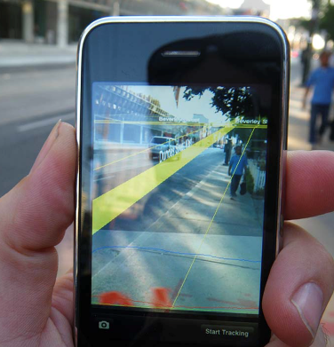
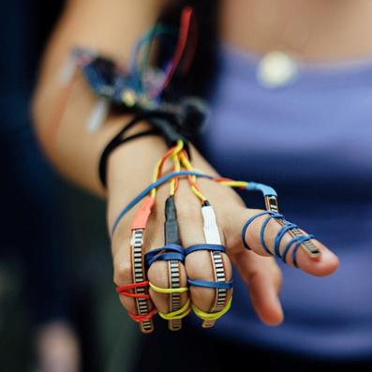
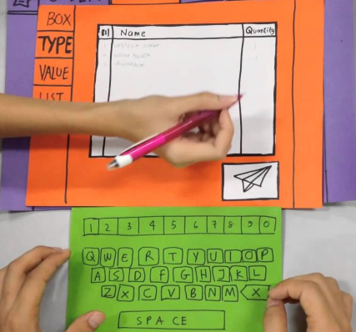
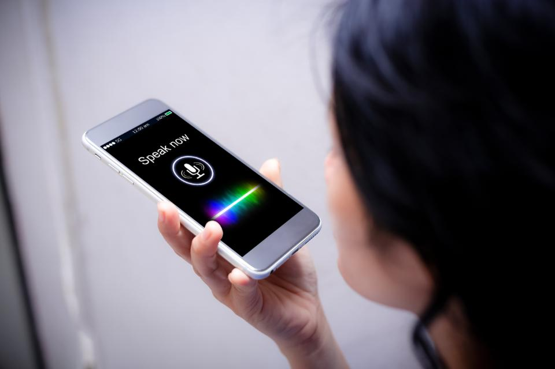

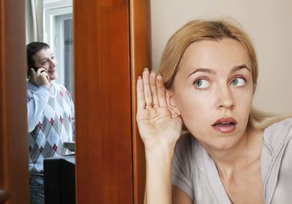
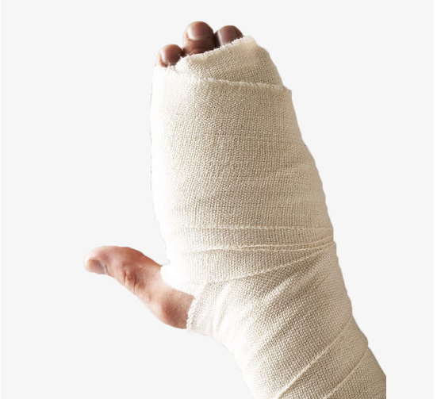

Background
Human-Computer Interaction (HCI)
Tongue and jaw movement-based HCI is good for privacy and allows interactions for those who have language barrier or poor finger coordination
Notes:
Being able to interact with the system naturally is becoming ever more important in the field of Human-Computer Interaction (HCI). In recent years, it has facilitated various types of HCI technology (e.g., speech recognition and gesture recognition). However, all of these manners are easy to be eavesdropped and only subject to healthy users
【click】Human-machine interface based on tongue-jaw movements has recently become one of the major technological trends.
Compared with gesture recognition and speech recognition technologies, it is good for privacy due to the hidden characteristic and allows interactions for those who have language barrier or poor finger coordination.

Slide 3
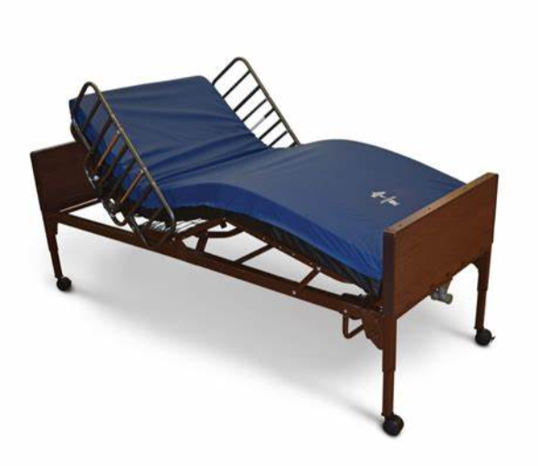
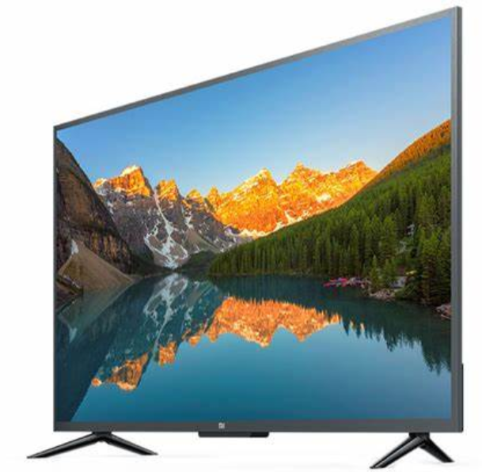
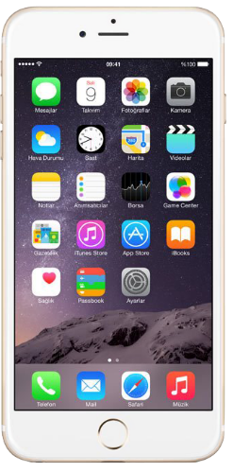
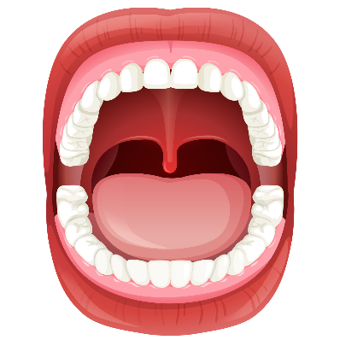
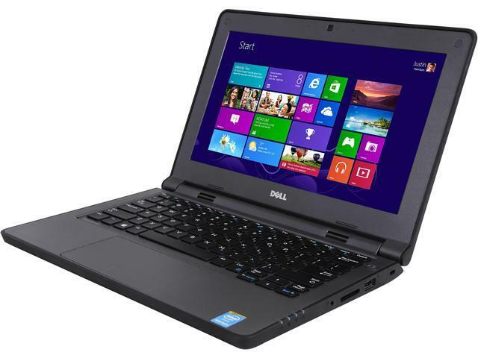
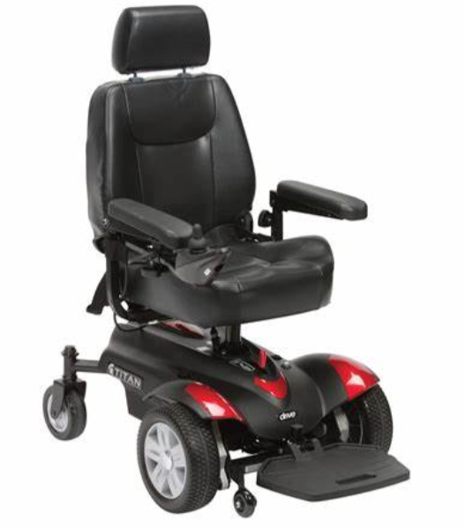

Background
Tongue and jaw movement-based HCI applications
Motorized Bed
TV
Control Unit
Smartphone
PC
Powered Wheelchair
Home Appliance
Notes:
tongue and jaw movement can present rich information with diverse motion combinations.
Therefore, there is of great interest to develop a recognition algorithm for tongue-jaw movement and converts them into user control commands, which are then communicated to the targeted devices in the user’s environment.

Slide 4
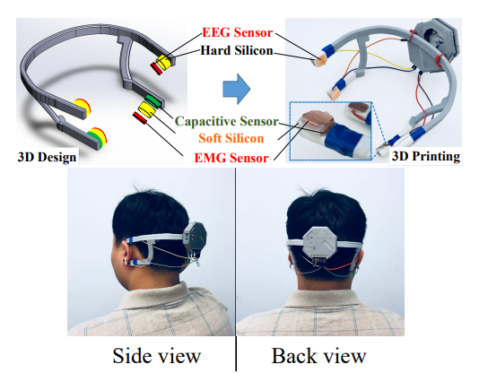
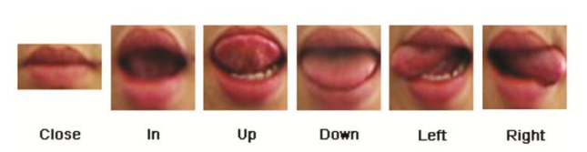
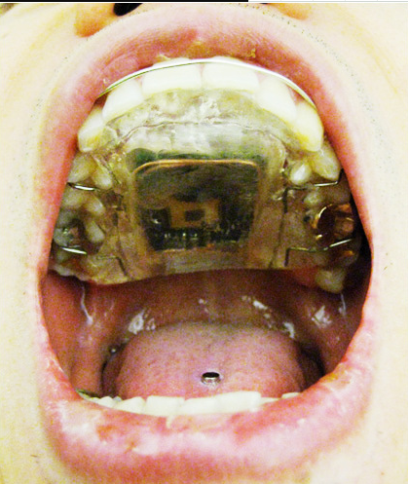
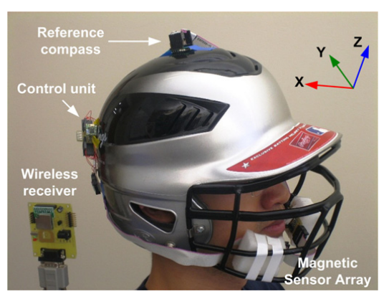
Existing Tongue-Jaw Movement Recognition Approaches
Computer Vision
Only outside-mouth tongue movements can be detected.
Oral Cavity Devices
Hygiene and intrusion disadvantages
Impair verbal communication and other oral functions
Wearable Devices
Require dedicated hardware with high cost
Obtrusive
Only outside-mouth tongue movements can be detected.
Hygiene and intrusion disadvantages
Impair verbal communication and other oral functions
Require dedicated hardware with high cost
Obtrusive
Notes:
Existing tongue-jaw movement recognition methods can be divided into three groups, which rely on cameras, oral cavity devices and wearable devices. These methods suffer from the following limitations: 【click】 for vision based methods, the advantage of hiding interactions is broken because only the out-of-mouth tongue movements can be recognized for interaction. 【click】 for oral cavity device based methods, they not only suffer from obvious hygiene and intrusion disadvantages, but also may impair verbal communication and other oral functions, and 【click】 for wearable device based methods, they require dedicated hardware with high cost, which makes them difficult to be adopted widely.

Slide 5
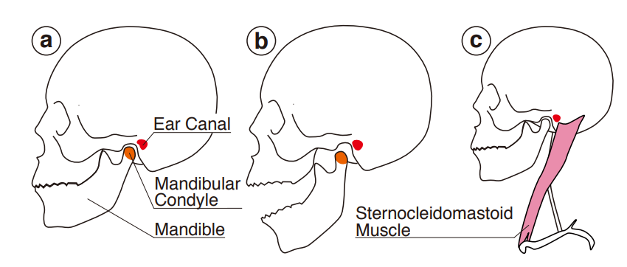
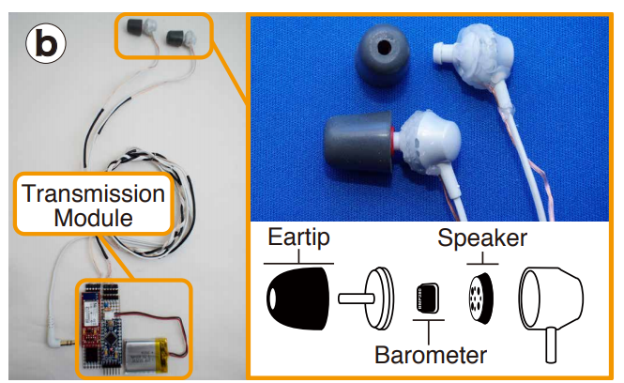

Ear Canal Sensing
When a user performs a face-related movement, the musculoskeletal system changes, affecting the shape of the ear canals
Prior Contributions in Ear Canal Sensing
Require dedicated hardware
Uncomfortable
Safety concerns
Notes:
A portion of the musculoskeletal system used to move the jaw, face, and head related to the ears is illustrated in the figure. When a user performs a face-related movement, the musculoskeletal system changes, affecting the shape of the ear canals.
Thus，The ear canal, which reflects the mouth-related activities, has drawn significant attention in recent years.
Some prior contributions have been made in capturing ear pressure signals using barometers embedded in earbuds to detect facial expressions, head movements, and tongue movements.
【click】However, measuring ear pressure changes requires to seal the ear canal, which can significantly affect hearing.
Meanwhile researchers have investigate place electrodes [20], infrared LEDs [21], and proximity sensors inside the ear canal to capture ear canal deformation。
But placing sensors inside the ear canal is uncomfortable and brings safety concerns. S

Slide 6
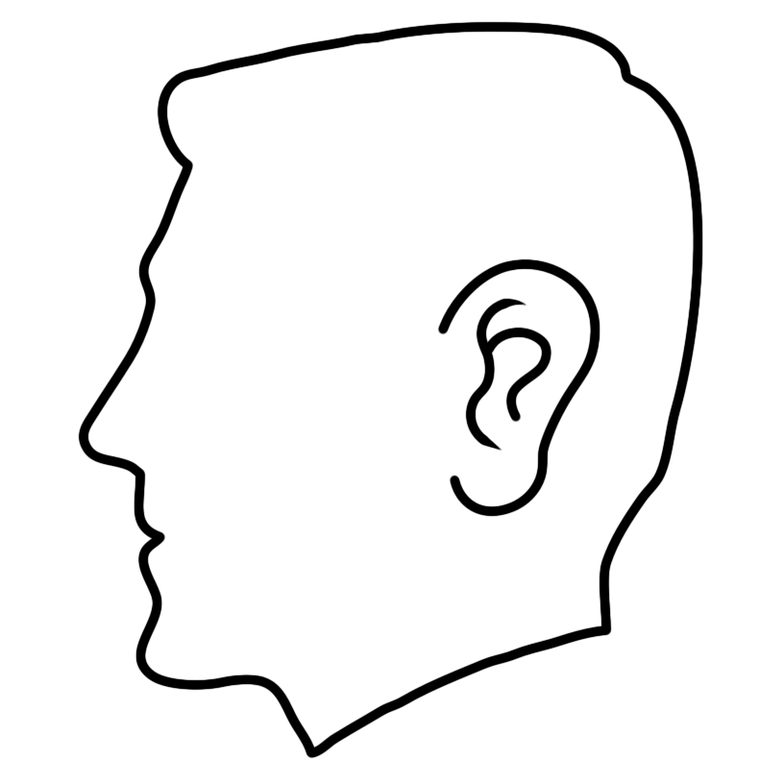
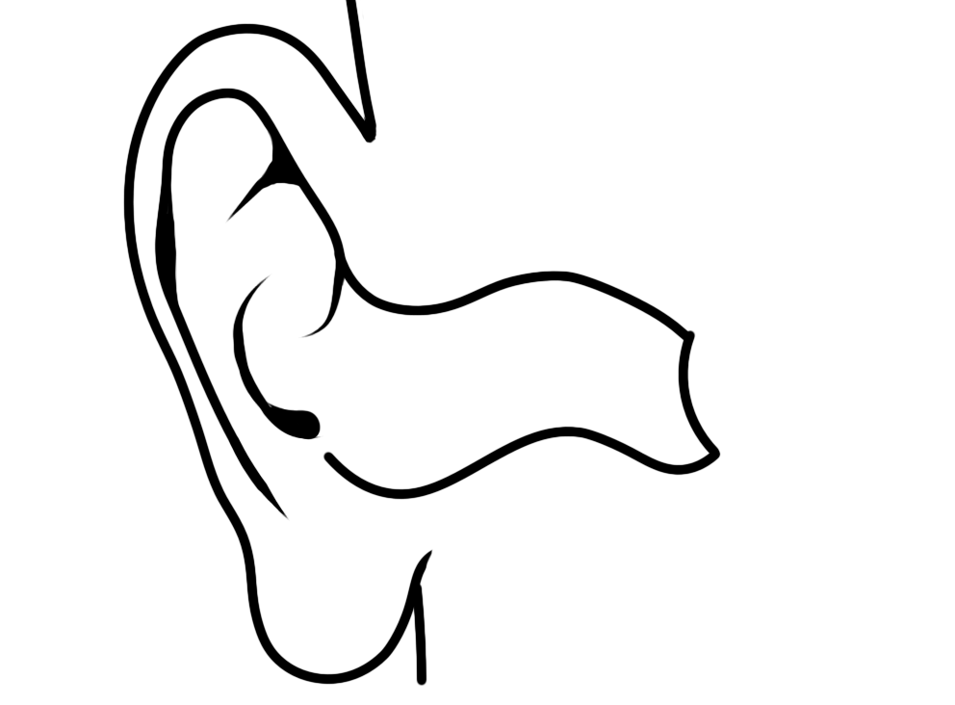




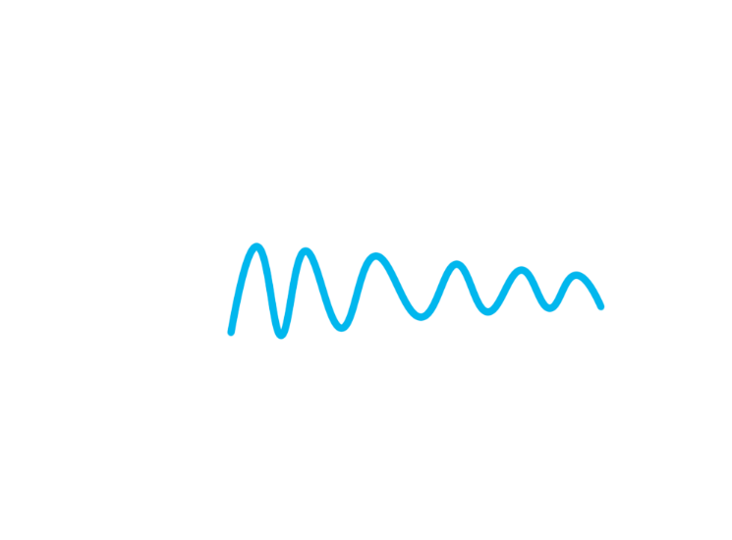






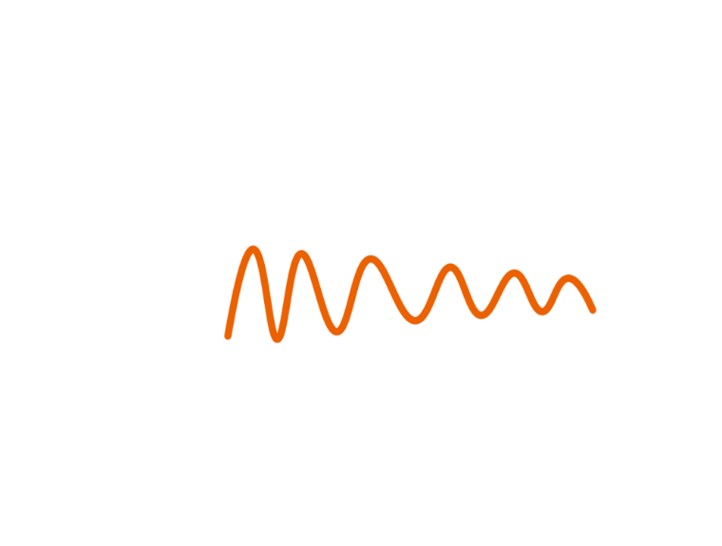

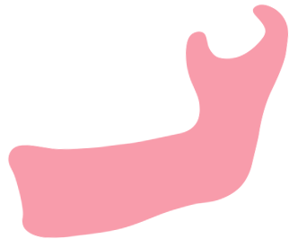

Basic Idea
Different tongue-jaw movements cause different amounts of movements of the ear canal wall in anterior-posterior, superior-inferior, and medial-lateral.
Smartphone
Notes:
The above limitations motivate us to design a nonintrusive tongue-jaw movement recognition system, called CanalScan, which uses speaker and microphone integrated into ubiquitous off-the-shelf devices (e.g., smartphones) to detect tongue-jaw movements.
The basic idea emerged from our finding that different tonguejaw movements cause different amounts of movements of the ear canal wall in anterior-posterior, superior-inferior, and medial-lateral。
---------------------------
【click】the speaker and microphone serve as an active sonar that sends an acoustic signal into the ear canal and captures acoustic reflections. 【click】As the ear canal wall moves upon tongue-jaw movements, 【click】multi-path reflections interfere with each other,which leads to reflections with strength corresponding to the direction, speed, and intensity of the movement of the ear canal wall. These reflections are decoded for tongue-jaw movement recognition.

Slide 7
Basic Idea
Challenge:
Multi-path reflections are highly sensitive to ear canal shape and the relative position between the smartphone acoustic sensors and the ear canal.
It is challenge to distinguish tongue-jaw movement with other movements.
People exhibit different patterns for the same tongue-jaw movement and perform movement slightly differently from time to time.
Notes:
We focus on six movements as shown in the figure。
These tongue-jaw movements are performed in different areas of the oral cavity
---------------------------
.【click】To recognize these tongue-jaw movements, we encontor three challenges
【click】Firstly,Multi-path reflections are highly sensitive to ear canal shape and the relative position between the smartphone acoustic sensors and the ear canal, which makes it intractable to extract reliable features for recognition.
【click】Secondly, The presence of extra movements between tow consecutive tongue-jaw movements, facial expressions, and head movements are common in real-world usage. They introduce jitter and pause similar to tongue-jaw movements in the received multi-path reflections [7], [9], which is challenging to distinguish.
【click】Thridly, We observe that people exhibit different patterns for the same tongue-jaw movement and perform movement slightly differently from time to time. This makes it hard for the system to realize robust and user-independent recognition for tongue-jaw movements.

Slide 8
Observations
Feasibility
Unique Patterns :the same number of peaks, the same or near positions for peak, trough, and turning point.
Interference
differences in curve shape and signal amplitude
Notes:
To understand the relationship between ear canal deformation and multi-path reflections, we recruit two volunteers to perform six tongue-jaw movements. We extract the multi-path reflection envelope in the time window and illustrate examples of the vibration patterns of six tongue-jaw movements in the figure.
【click】
We can easily observe that each kind of tonguejaw movement has unique patterns in the reflection envelope, such as the same number of peaks, the same or near positions for peak, trough, and turning point. This demonstrates the feasibility of characterizing different tongue-jaw movements based on multi-path reflection from the ear canal.
-------
【click】Meanwhile, we can observe that curve shape and signal amplitude are different across people and instance.
----------
In conclusion, the presence of peak and trough is caused by changing movement directions of the ear canal wall. The curve shape and signal amplitude are related to ear canal shapes and sensor positions.

Slide 9
Overview
Address sensor position-sensitive deficiency and ear-canal-shape-sensitive deficiency in multi-path reflections
Accurately segment actual tongue-jaw movements.
Enable user-independent recognition
Reduce the impacts of ear canal shape diversity and sensor position difference on the received signals.
Notes:
This is the framework of CanalScan system. The system includes four parts:
【click】the first part is Acoustic Signal Collection, the earpiece speaker and top microphone of a smartphone serve as an active sonar, which generates inaudible acoustic signals and collects their reflections. Sensor Position Detection is performed to monitor the relative position between acoustic sensors and the ear canal thus to assist users in placing the acoustic sensors in the same valid zone every time they use CanalScan.
【clik】The second part is Tongue-Jaw Movement Segmentation, we first segment all possible movement frames with a dynamic threshold. We then use a pre-trained Support Vector Domain Description (SVDD) [10] classifier to select real tongue-jaw movements from extra movements and non-tongue-jaw movements
【click】The third part is Multi-path Reflection Instability Reduction, we transform the input signal into a new signal with characteristics of the target vector。The data transformation mechanism to reduce the impacts of ear canal shape diversity and sensor position difference on the received signals.
and 【click】the fourth part is Tongue-Jaw Movement Recognition. We extract twelve features and use A Random Forest (RF) classifier to recognize tongue-jaw movements.
【click】Throughout the whole process, the challenges are addressed, which is the main contributions of this paper.
Next, I will introduce different modules in our system. Lets first see the Acoustic Signal Collection.

Slide 10
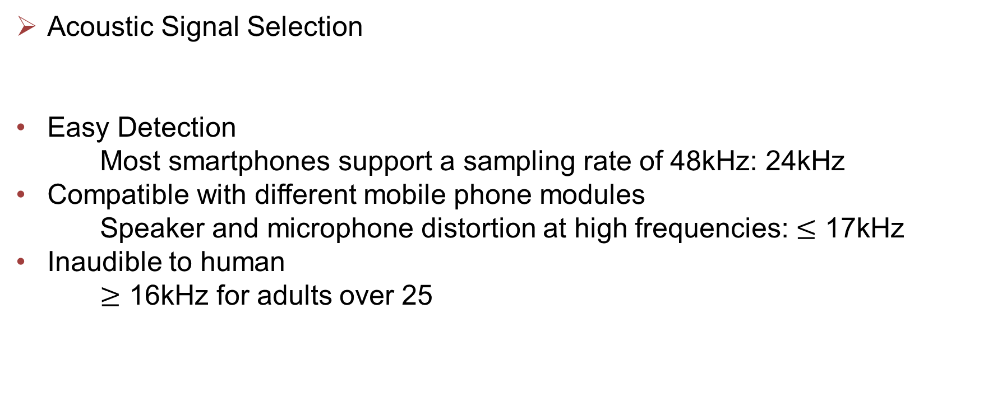
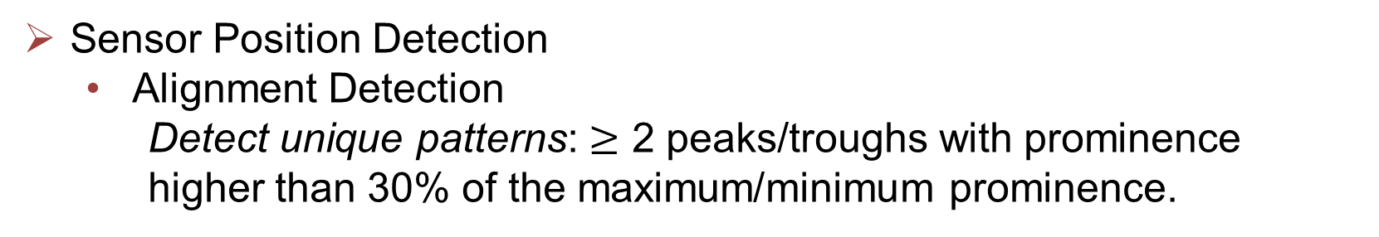
Acoustic Signal Collection
Selected Frequency
Acoustic Signal Selection
Easy Detection
Most smartphones support a sampling rate of 48kHz: 24kHz
Compatible with different mobile phone modules
Speaker and microphone distortion at high frequencies: $≤$ 17kHz
Inaudible to human
$≥$ 16kHz for adults over 25
kHz
0
16
17
22
Sensor Position Detection
Alignment Detection
Detect unique patterns: $≥$ 2 peaks/troughs with prominence higher than 30% of the maximum/minimum prominence.
requirement: alignment, minimal position difference
Notes:
[Start]. We design the acoustic signal to satisfy several demands.
[Click]. Consider that the sampling rate supported by mainstream smartphones is 48kilohertz, the frequency of signal can not be higher than 24kHz according to Nyquist sampling theorem.
[Click]. Besides,the signal should be as inaudible as possible to avoid annoyance. So an ideal frequency should be over 16 KHz.
[ [Click]. Distortion sometimes occur in high frequency, therefore, the signal should below 17kHz.
[Click]. Finally, we select signal with fixed frequency of 16kHz. The sampling rate is 48kHz.
To collect multi-path reflection data, two conditions need to be fulfilled. 【click】One is to allow the sensor to collect effective multi-path reflection. . In other words, the sensor should be aligned with the ear canal. The other is to minimize the relative position difference between the sensor and the ear canal entrance
【click】Thus, we let users perform a pre-agreed tongue-jaw movement, and determine whether the acoustic sensors are aligned with the ear canal by checking whether the reflection envelope has more than two peaks or troughs with prominence higher than 30% of the maximum prominence of the highest peak and lowest though, which is observed through experiments.

Slide 11
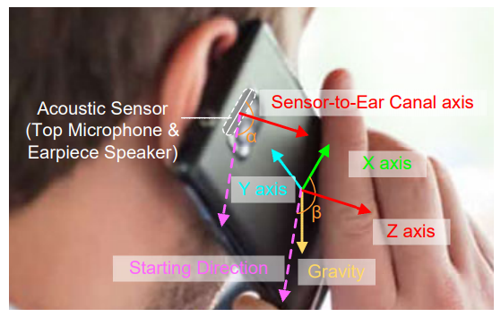
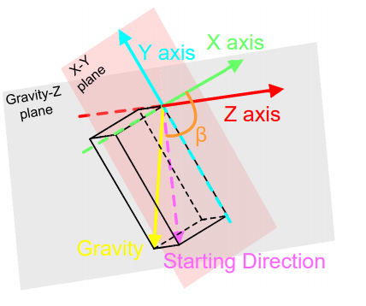
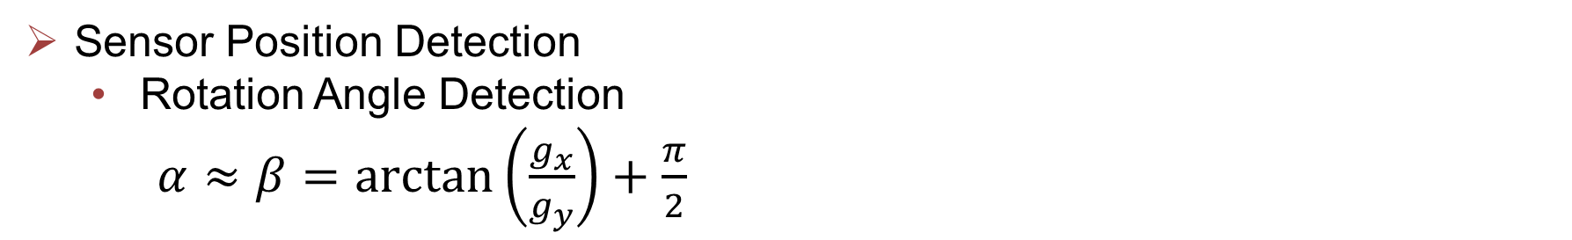
Acoustic Signal Collection
Sensor Position Detection
Rotation Angle Detection
$α≈β=\arctan\left(\frac{g_{x}}{g_{y}}\right)+\frac{π}{2}$
CanalScan guides the users to rotate the smartphone at the same or similar angle when collecting signals.
Notes:
The position difference is mainly affected by the rotation angle of the acoustic sensors,
The left figure shows an example of the coordinate systems。
The sensor rotate α degrees and smartphone rotates β degrees
When the acoustic sensor is aligned with the ear canal, .We can easily derive that α equals to β,.
The right figure shows the relationship between gravity-z plane and the smartphone x-y axis plane ,
【click】 β can be calculated by this equation, where gx and gy is the gravity component in X and Y axis.
【click】By calculating the smartphone rotation angles, we guide the users to rotate the smartphone at the same or similar angle when collecting signals. Thus, we can minimize the relative position difference between the acoustic sensor and the ear canal during each collection and mitigate the impacts of various relative positions on multi-path reflections.

Slide 12
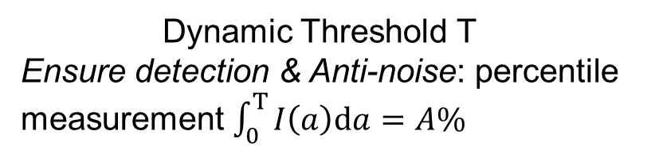
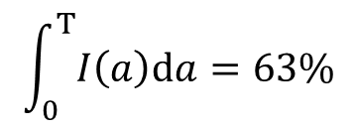
Tongue-Jaw Movement Segmentation
Movement Segmentation
The tongue and jaw pause for a very short while between two consecutive movements
1st derivatives
Dynamic Threshold T
Ensure detection & Anti-noise: percentile measurement $\int_{0}^{T}{I\left(a\right)\text{d}a=A\%}$
$$\int_{0}^{T}{I\left(a\right)\text{d}a=63\%}$$
Movement Segmentation segments all movements：tongue-jaw movements, extra movement between two consecutive movements, facial expression, head movement.
Notes:
The tongue and jaw pause for a very short while between two consecutive tonguejaw movements to felicitate segmentation
Therefore, 【click】the first derivatives of jitters are high, and the first derivatives of pauses are low and relatively stable. 【click】We can use a threshold to detect movements
But, finding a threshold suitable for everyone is extremely difficult due to diversity in movement amplitude range and noise uncertainty.
Therefore, we use a dynamic threshold.
【click】we first calculate the intensity distribution of the absolute value of the first derivative of input data。
【click】. Then, the threshold T is calculated by using a percentile measurement procedure。
【click】We set A as 63 based on our experimental study.
【click】Movement Segmentation segments all movements， including tongue-jaw movements, extra movement between two consecutive movements, facial expression, and head movement。To avoid high computational costs and misclassification, we need to select tongue-jaw movements from other movements.

Slide 13
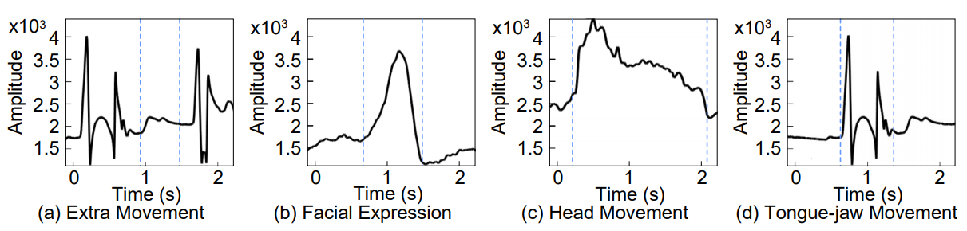
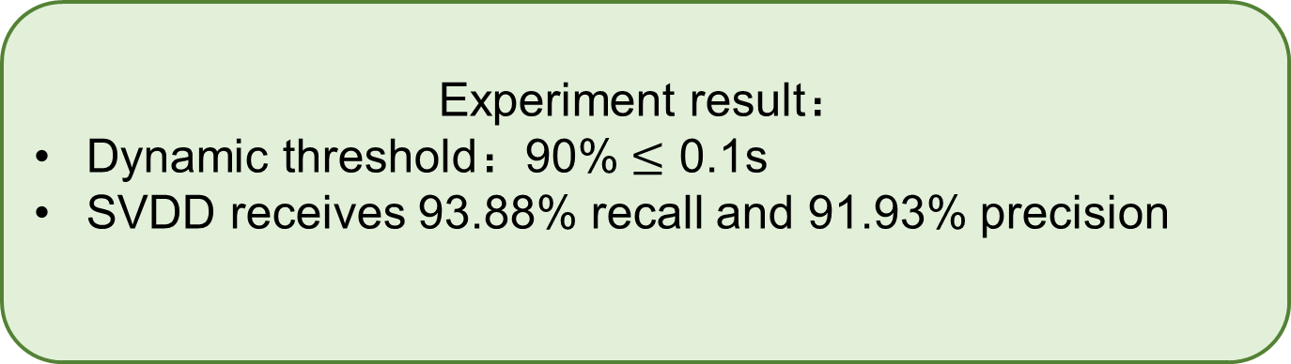
Tongue-Jaw Movement Segmentation
Tongue-Jaw Movement Detection
Tongue-Jaw Movements have more peaks, and the peaks are sharper.
Feature Extraction
kurtosis, standard derivation, length, and the number of peaks.
Tongue-Jaw Movement Selection
One-class classifier: Support Vector Domain Description (SVDD)
Experiment result：
Dynamic threshold：90% $≤$ 0.1s
SVDD receives 93.88% recall and 91.93% precision
Notes:
The figure illustrates the envelope of other movements, and actual tongue-jaw movement, respectively.
【click】We can observer that tongue-jaw movements have more peaks, and the peaks are sharper.
Inspired by this observation ，【click】We first extract features to represent each segmented movement【click】Then, we employ a one-class classifier, SVDD
SVDD determines the boundary of the tongue-jaw movement-class and assigns a sample to that class according to whether it falls within or outside the boundary. After that, only actual tongue-jaw movements are left.
【click】
By using the dynamic threshold method ，90% of the time difference between segments and ground truth is less than 0.1s,
Furthermore， SVDD receives 93.88% recall and 91.93% precision，which demonstrates the effectiveness of the proposed method.

Slide 14
Multi-path Reflection Instability Reduction
Guidelines:
Data from the same tongue-jaw movement should be more similar after transformation.
Data from different tongue-jaw movements should be distinct after transformation.
Ear canal shape & sensor position
Motional information
Curve shape, peak amplitude
Number of peaks, relative peak/trough position
Notes:
Multi-path reflections are highly sensitive to ear canal shape and the relative position between the smartphone acoustic sensor and the ear canal. To overcome this, we propose a data transformation technique. Such a transformation technique involves two design guidelines:【click】
Data from the same tongue-jaw movement should be more similar after transformation.
Data from different tongue-jaw movements should be distinct after transformation.
【click】Considering that ear canal shape and sensor position mainly affect curve shape and peak amplitude 【click】 while motional information are related to number of peaks and relative peak/trough position.
we need to modify information related to ear canal shape and sensor position while keeping motional information unchanged.

Slide 15
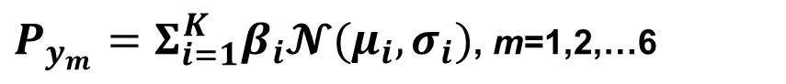
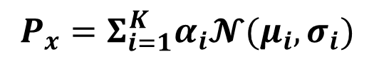
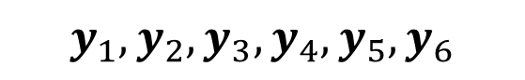

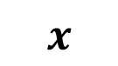
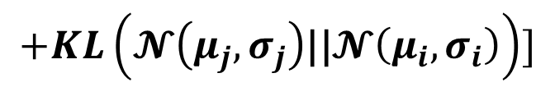
Multi-path Reflection Instability Reduction
$$P_{x}=Σ_{i=1}^{K}α_{i}𝓝(μ_{i},σ_{i})$$
$$D_{i,j}=1/2[KL\left(𝓝\left(μ_{i},σ_{i}\right)\text{||}𝓝\left(μ_{j},σ_{j}\right)\right)$$
$P_{y_{m}}=Σ_{i=1}^{K}β_{i}𝓝(μ_{i},σ_{i})$, m=1,2,…6
$$+KL\left(𝓝\left(μ_{j},σ_{j}\right)\text{||}𝓝\left(μ_{i},σ_{i}\right)\right)]$$
Experiment result：
Recall：improved from 69.35% to 91.41%
Precision： improved from 70.46% to 91.58%
$$y_{1},y_{2},y_{3},y_{4},y_{5},y_{6}$$
$$ℱ\left(x\right)=E(y^{′}|x)$$
$$x$$
$$P_{y’}=Σ_{i=1}^{K}γ_{i}\left\{𝓝\left(μ_{i},σ_{i}\right)\right|\min_{}{D_{i,j}}\}$$
Notes:
Now we introduce the Data Transformation Process
【click】Besides the input signal, We random select envelope samples of six tongue-jaw movements.
【click】 We first adopt the DTW method to process them. After that, the input signal and envelope samples are time-aligned.
【click】 We then apply Gaussian Mixture Model to represent them as the sum of K multivariate Gaussian function
【click】in the third step，we adopt the Kullback–Leibler divergence to measure the distance of two Gaussian components
【click】Then, we search the distance matrix to find K components from the Gaussian distribution set that are most similar to the K components from the input data. We add up the selected components in the form of Gaussian Mixture Model to obtain probability density of the representative target vector y’:
【click】the last step is to transform the collected data x into the target vector y’.
Using more components can better model the signal, but also cause high computational costs. In our case, 12 components are used.
【click】Experiment result show that the data transformation method improves the average recall from 69.35% to 91.41%, and the average precision from 70.46% to 91.58%.

Slide 16
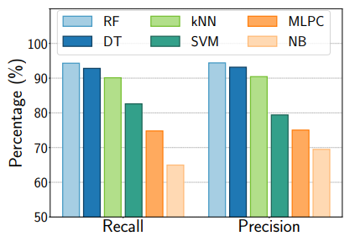
Tongue-Jaw Movement Recognition
Feature Extraction
Can similarity matching approaches work？
It is difficult to generate standard templates for each type of tongue-jaw movement.
Tongue-Jaw Movement Classification
Random Forest (outperform than other
approaches)
variance, absolute energy, vectorized approximate entropy, autocorrelation, count above/below mean, the first location of maximum/minimum, linear least-squares regression, the mean over the absolute differences between subsequent time series values, mass center index, and energy ratio of ten chunks.
Notes:
Now， we introduce the recognition of tongue-jaw movements
【click】Intuitively, we can recognize different tongue-jaw movements with similarity matching (e.g., DTW method).
【click】However, it is arduous to generate standard templates for each type of tongue-jaw movement because of the diversity of movements performed by different users.
【click】Instead, we extract this 12 unique and consistent statistic features。
【click】 for classification， we compare the performance of several highly used classifier including Random Forest (RF), Decision Tree (DT), k-Nearest Neighbor(kNN), radial basis function kernel Support Vector Machine (SVM), Multi-layer Perceptron Classifier (MLPC), and Naive Bayes (NB),
We find that RF classifier outperforms than the other classifiers, so， we employ RF to recognize different tongue-jaw movements.

Slide 17
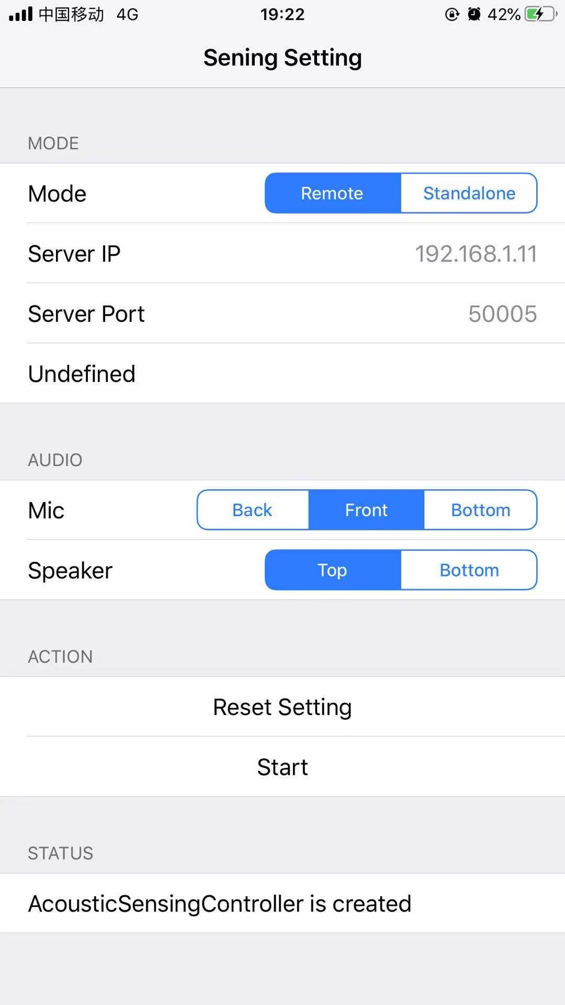
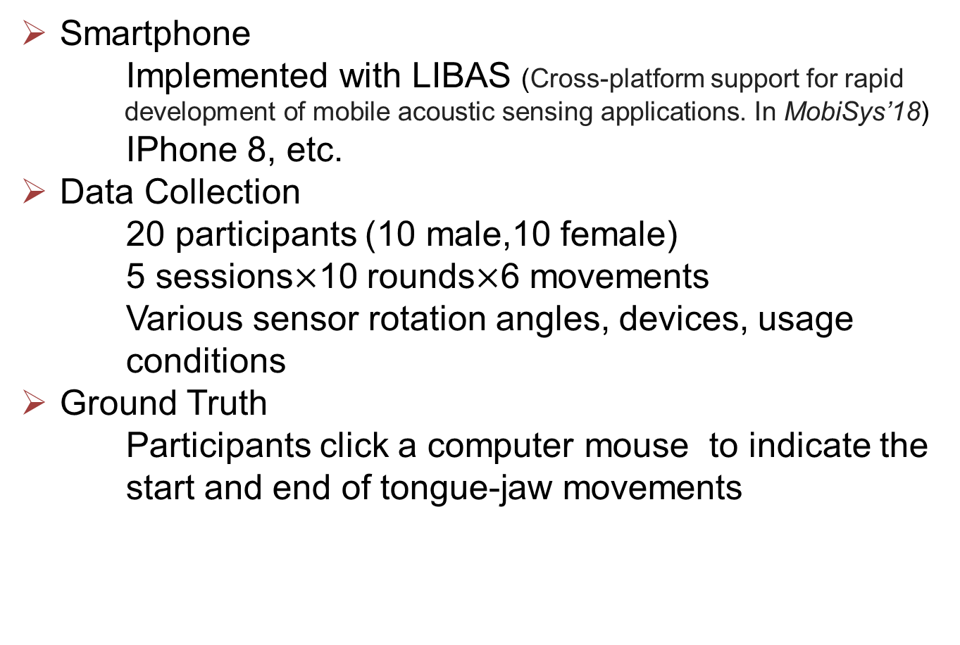
Experimental Setup
Smartphone
Implemented with LIBAS (Cross-platform support for rapid development of mobile acoustic sensing applications. In MobiSys’18)
IPhone 8, etc.
Data Collection
20 participants (10 male,10 female)
5 sessions$×$10 rounds$×$6 movements
Various sensor rotation angles, devices, usage conditions
Ground Truth
Participants click a computer mouse to indicate the start and end of tongue-jaw movements
LIBAS Interface
Notes:
To evaluate canalscan, we recrute 20 volunteers to collect tongue-jaw movement data with smartphones.
we implement LIBAS on the smartphones as shown in the figure.
Participants are asked to respectively perform the six tongue-jaw movements for 5 sessions, each session includes 10 rounds, and each round lasts 2-4 minutes
We also collect data under various issues. The start and end of each tongue-jaw movement are indicated by clicking a computer mouse using their left hands.

Slide 18
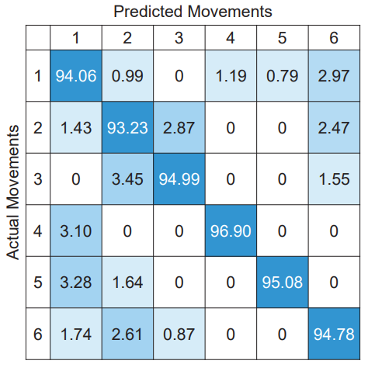
Tongue-Jaw Movement Recognition Performance
Recall: 94.84%
Precision: 95.00%
Notes:
We conduct five-fold cross-validation to evaluate the tonguejaw movement recognition performance of CanalScan.
The figure shows the confusion matrix of the recognition results of CanalScan.
【click】The average recall and precision of CanalScan are 94.84% and 95.00%, respectively.

Slide 19
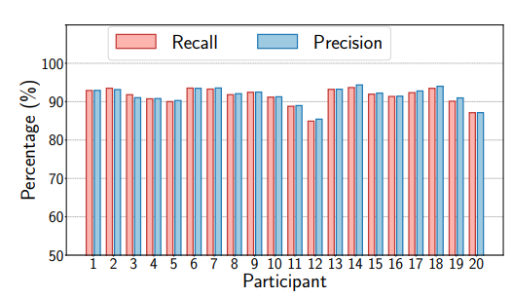
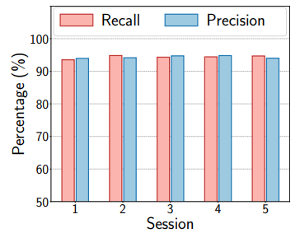
Use Issue Study
Universality
Stability
Recall: 91.41%
Precision: 91.58%
Recall: 94.35%
Precision: 94.33%
Notes:
Then We study the performance of CanalScan from many aspects.
Firstly, we evaluate whether CanalScan can generalize to new users without retaining or adaptation, We use data from one participant for testing and data from nineteen participants for training.
the average recall and precision are 91.41%, and 91.58%, respectively
Secondly, We evaluate the stability of CanalScan against movement inconsistency,
We use data from one session for testing and the remaining data for training.
the results reach 94.35% average recall and 94.33% average precision across sessions.
These excellent results confirm that CanalScan works effectively across different users and sessions.

Slide 20
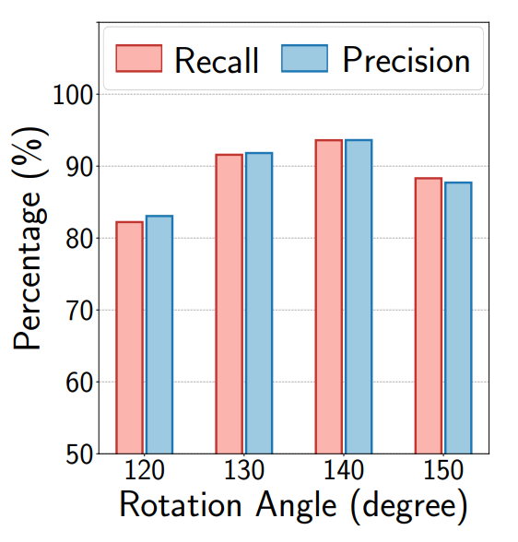
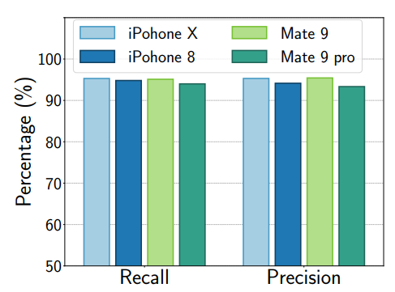
Use Issue Study
Sensor Rotation Angle
Device
Long-Term Performance
Training Data | First phase | Mixed data (75%)
Testing Data | One month later | Mixed data (25%)
Recall | 92.26% | 94.06%
Precision | 92.18% | 93.64%
Recall: 82.22%, 91.58%, 93.60%, 88.31%
Precision: 83.06%, 91.82%, 93.62%, 87.71%
Notes:
Thirdly, To understand the impact of sensor rotation angles, we test the system with four angles, including 120 degrees, 130 degrees, 140 degrees, and 150 degrees.
The recall results of four cases are 82.22%, 91.58%, 93.60%, and 88.31%. The precision of four cases are 83.06%, 91.82%, 93.62%, and 87.71%, respectively.
CanalScan receives the highest recall and precision at 140degrees.
Fourthly, we evaluate the system performance with different smartphones, we conduct cross-validation experiments on data collected from four devices including iPhone X, iPhone 8, HUAWEI Mate 9, and HUAWEI Mate 9pro, These devices differ in size and audio hardware.
The right figure shows the comparison of the recall and precision across four devices.
There is no noticeable difference in their tongue-jaw movement recognition results. This indicates that our system is compatible with different mobile phone modules.
Also, we conduct long-term validation. When use data collected in the first data collection phase for training and data collected one month later for testing, the average recall is 92.26%, and the average precision is 92.18%. Meanwhile, when use mixed data, recall and precision reaches 94.06% and 93.64%.
The results suggest a regular update of the training data set of CanalScan enables high accuracy tonguejaw movement recognition

Slide 21
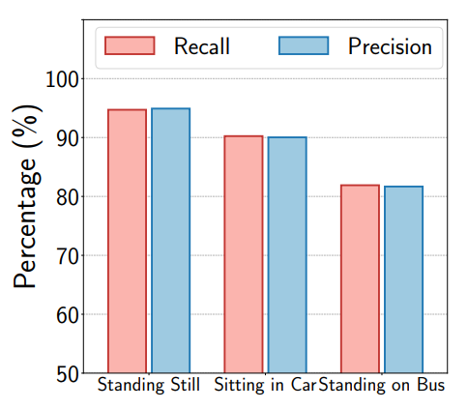
Usage Scenarios
Three conditions:
standing still, standing on a moving bus, and sitting in a moving car
Standing still
Recall: 94.71%
Precision: 94.91%
Sitting in a car
Recall: 90.24%
Precision: 90.03%
Standing on a bus
Recall: 81.90%
Precision: 81.68%
Notes:
To validate if CanalScan can work well in various usage scenarios, we ask the participants to collect data in three conditions: standing still, standing on a moving bus, and sitting in a moving car.
【click】Standing still yields the highest recall and precision, which are 94.71% and 94.91%, respectively.
【click】The performance of sitting in a moving car is slightly worse. The recall decreases to 90.24%, and precision decreases to 90.03%,
【click】As for standing on a moving bus, body vibration obfuscates acoustic reflections in the ear canal, resulting in 81.90% recall and 81.68% precision.

Slide 22
CONCLUSION
We propose a nonintrusive tongue-jaw movement recognition system.
The first to develop a tongue-jaw movement-based human-computer interface in off-the-shelf devices.
We propose a set of novel algorithms
Sensor position detection method
Multi-path instability reduction method
Movement segmentation method
Explore twelve kinds of features
We implement CanalScan and conduct experiments with 20 participants
CanalScan reaches the goal of accurate, robust, and userindependent recognition of six tongue-jaw movements.
Notes:
In this paper, we propose a nonintrusive tongue-jaw movement recognition system, CanalScan.
To the best of our knowledge, we are the first to develop a tongue-jaw movement-based human-computer interface in off-the-shelf devices
We design a set of novel techniques including a sensor position detection method and multi-path instability reduction method that overcome the ear-canal-shapesensitive deficiency and sensor-position-sensitive deficiency in multi-path reflections, and a movement segmentation method that accurately segments and selects tongue-jaw movements from other interference movements. Also, we explore twelve kinds of features and adopt RF for final classification.
Extensive experiments with twenty participants demonstrate that CanalScan reaches the goal of accurate, robust, and userindependent recognition of six tongue-jaw movements.

Slide 23
Thanks!
Thanks!
Thanks!
&
&
&
Questions
Questions
Questions
Yetong Cao
yetongcao@bit.edu.cn
Notes:
[Start]. That's all. Thanks for listening.

